Slide 1
Telecom Churn Case Study Summary Recommendations Business Implications
Submitted By:
Shubham Sharma

Slide 2
Telecom Churn Case Study - Summary 1. The data contains so many columns. Majorly the columns are based on a four-month window which we have to study and analyze using a good phase(June and July), an Action phase(August), and a Churn phase(September). 2. We derived some new features to study the change in the values of recharge and to derive features that can be indicators of churn. 3. We filter high-value customers so that from the business point of view, we can focus more on them. 4. We have made a new column by tagging churners based on the churn phase. Tagging churners majorly based on incoming calls, outgoing calls, 2g data, and 3d data usage of September month. 5. There is a data imbalance, so we have used SMOTE to deal with imbalanced data. 6. We have chosen a model based on best evaluation metrics.

Slide 3
Telecom Churn Case Study - Recommendations We have to majorly focus on the action phase. 1. Target those customers who are having fewer minutes of usage than the good phase. 2. Customers who have minutes of usage and 2g/3g data in the action phase less than that of the good phase, are likely to be churned. 3. Focus on the high-value customers, giving them more benefits from the company. 4. Customers with decreasing incoming minutes of usage in the action phase are more likely to churn.

Slide 4
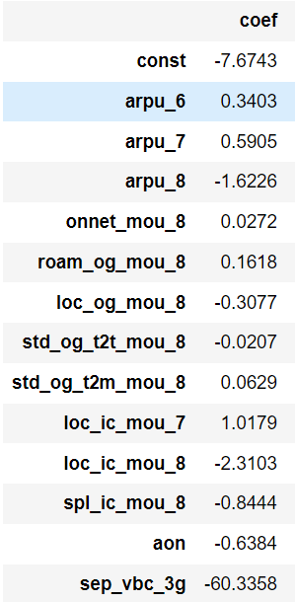
Telecom Churn Case Study – Business Implications 1. logistic Regression with no PCA. We are focussing on the below top predictors in the model logistic Regression with no PCA. Some variables are directly related and some are inversely related to the churn column. We have to focus on these features accordingly.

Slide 5
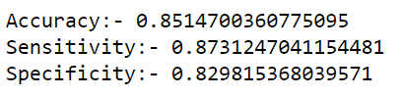

Telecom Churn Case Study – Business Implications 2. Decision Tree with PCA. Metrics for train data. Metrics for test data.

